Slide 1
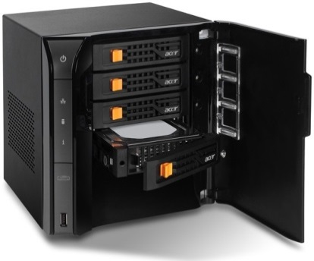
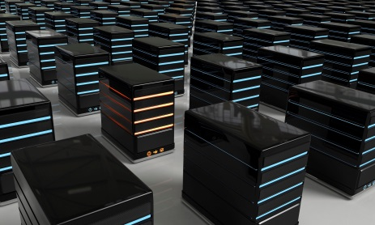
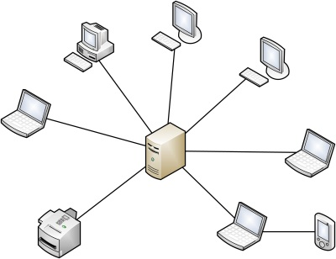
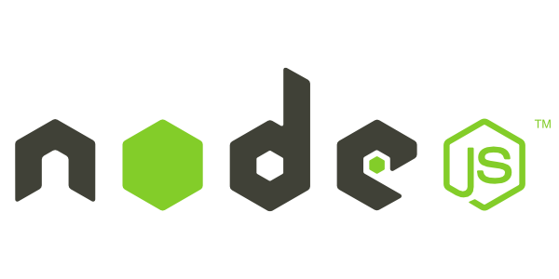
Introduction to NodeJS
What is the fuzz all about?
Telerik School Academy
Learning & Development
http://academy.telerik.com

Slide 2

Table of Contents
Console 2
Bring the awesome to the CMD
Overview of NodeJS
Running NodeJS applications
Modules
Third-party libraries

Slide 3
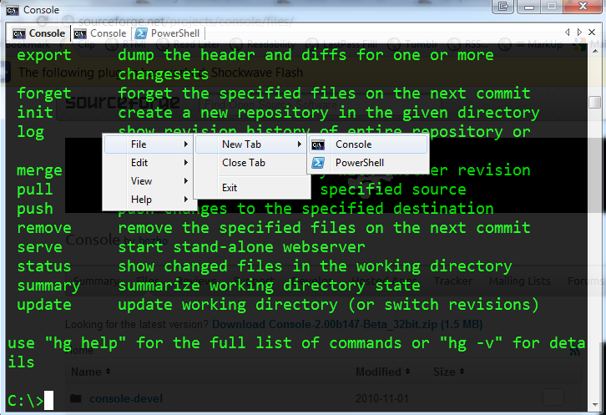
Console 2

Slide 4
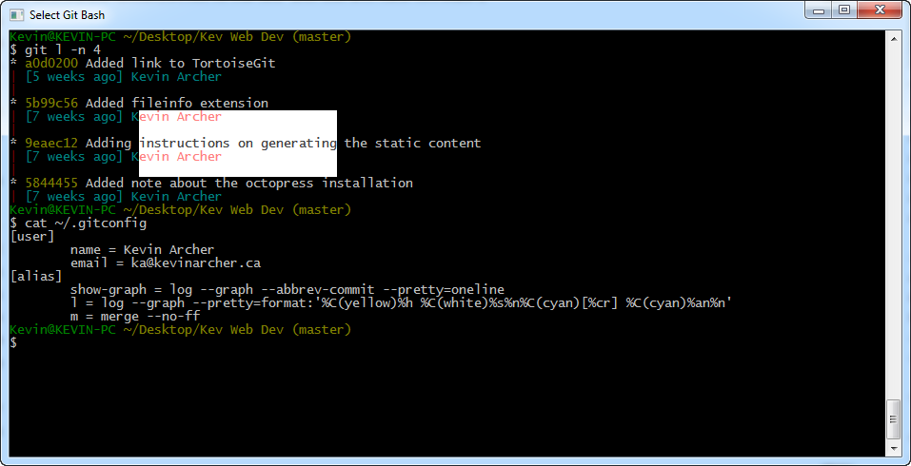
Console 2
Download from
http://sourceforge.net/projects/console/
Install
Customize as you wish
Bigger fonts
Brighter colors
Different tabs

Slide 5
Console 2
Live Demo

Slide 6
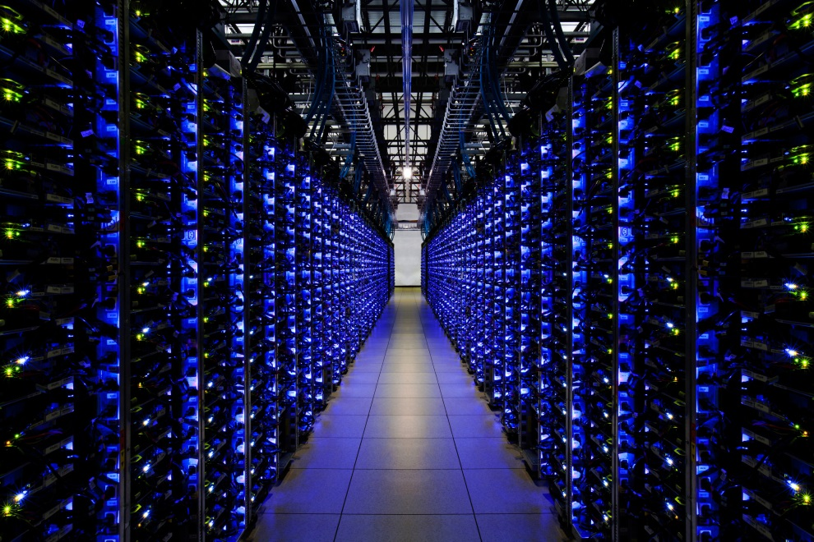
Overview of NodeJS

Slide 7
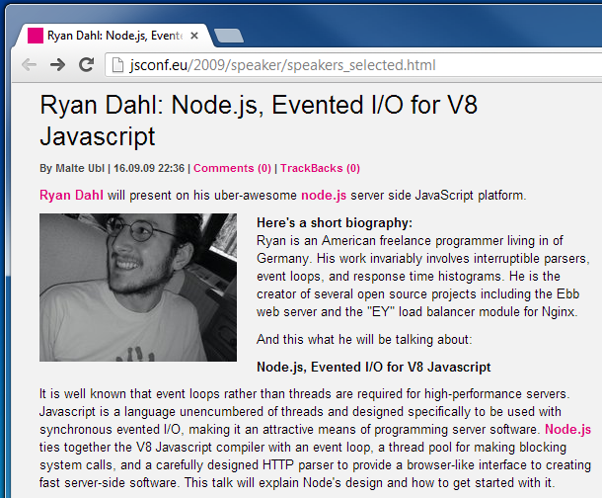
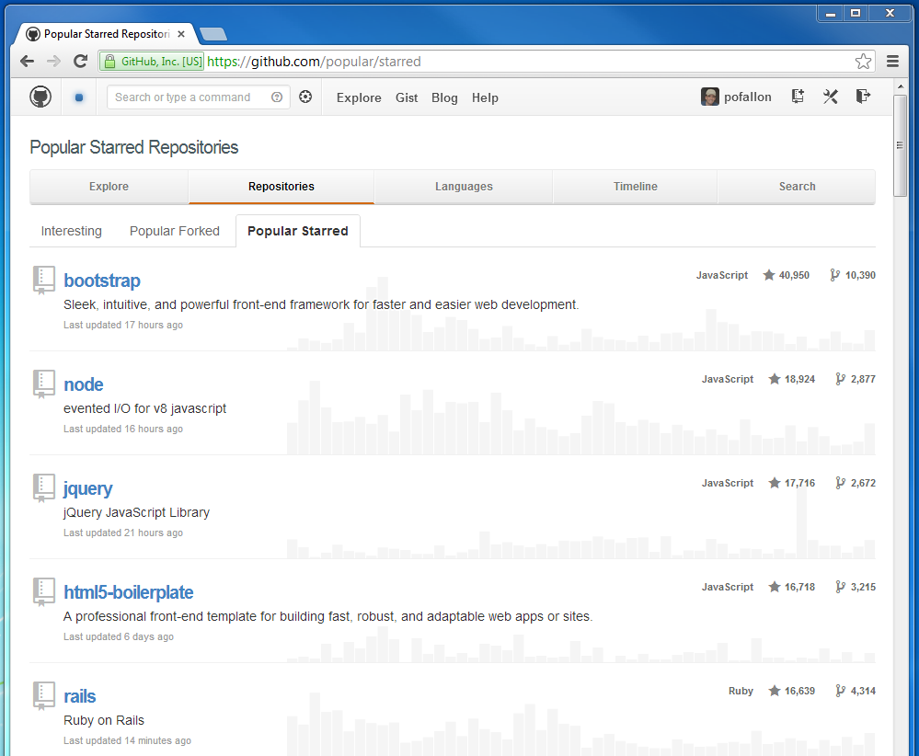
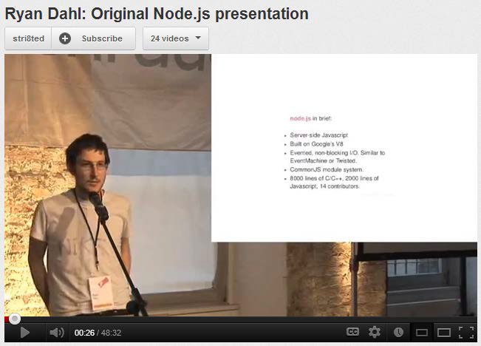
Overview of NodeJS
Background

Slide 8
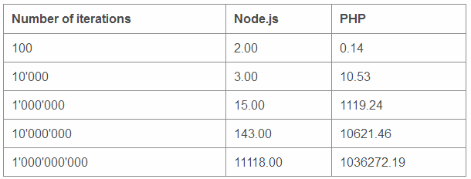
Why NodeJS
Node is written in JavaScript
One language on the server and the client
Full control of the server
Asynchronous and fast (callback oriented)

Slide 9
Building Blocks & Installation
NodeJS
libuv – high-performance event I/O library
V8 – Google Chrome's JavaScript engine
JavaScript -> C++
Installation
http://nodejs.org/
Run Command Prompt (cmd)
Type "node" and run it

Slide 10
Running NodeJS Applications
Live Demo

Slide 11

Restoring Modules

Slide 12
Restoring Modules
NodeJS uses modules
Some of them are third-party ones
The application needs them
Installed from Node Package Manager (NPM)
You need to have them installed locally
All packages must be restored if missing
Run the command: "npm install"

Slide 13
Restoring Modules
Live Demo

Slide 14
Introduction to NodeJS
http://academy.telerik.com

